Slide 1



Solution to Theory Quizz 2
Multi-Layer Perceptrons (MLP)
Master in Big Data Solutions 2020-2021 - Artificial Intelligence
Xavier Giró
xavier.giro@bts.tech

Slide 2
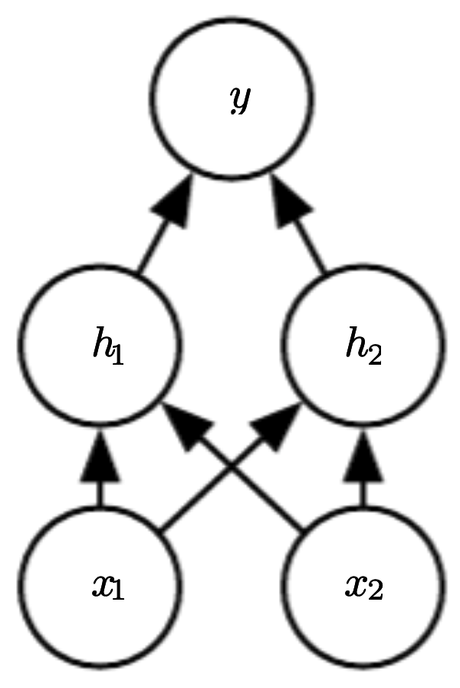
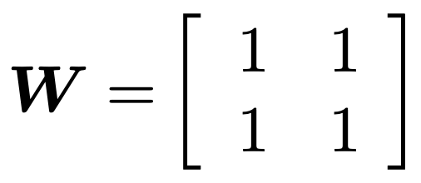
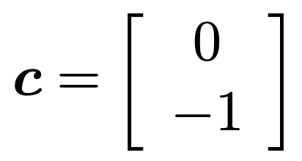
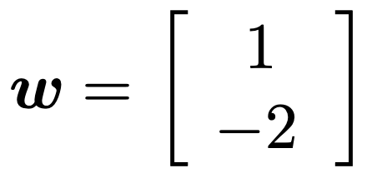
Multilayer Perceptrons - MLPs
Parameters of the first layer
Consider this neural network, given the parameters of its layers:
Parameters of the second layer
How many hidden layers are there ?
Compute h₁ and h₂ given an input x₁=0, x₂=0.
Consider an activation ReLU, g(h_{i}) = max(h_{i},0), between the first and second layer. Compute g(h₁) i g(h₂).
Compute the output value y for an input x₁=0, x₂=0.
Source: Section 6.1 from Ian Goodfellow, Yoshua Bengio, Aaron Courville, “Deep Learning”. MIT Press 2016

Slide 3
Multilayer Perceptrons - MLPs
Parameters of the first layer
Consider this neural network, given the parameters of its layers:
Parameters of the second layer
How many hidden layers are there ?
One.
Compute h₁ and h₂ given an input x₁=0, x₂=0.
h₁ = 0 · 1 + 0 · 1 + 0 = 0 + 0 + 0 = 0
h₂ = 0 · 1 + 0 · 1 - 1 = 0 + 0 -1 = -1
Source: Section 6.1 from Ian Goodfellow, Yoshua Bengio, Aaron Courville, “Deep Learning”. MIT Press 2016

Slide 4
Multilayer Perceptrons - MLPs
Parameters of the first layer
Consider this neural network, given the parameters of its layers:
Parameters of the second layer
c) Consider an activation ReLU, g(h_{i}) = max(h_{i},0), between the first and second layer. Compute g(h₁) i g(h₂).
g(h₁) = ReLU(0) = 0
g(h₂) = ReLU(-1) = 0
d) Compute the output value y for an input x₁=0, x₂=0.
y = 0 · 1 + 0 · (-2)= 0 + 0 = 0
Source: Section 6.1 from Ian Goodfellow, Yoshua Bengio, Aaron Courville, “Deep Learning”. MIT Press 2016

Slide 5
Multilayer Perceptrons - MLPs
e) Complete the table with the results from the previous exercise. What logic gate is implemented by the neural network ?
x1 | x2 | h1 | h2 | g(h1) | g(h2) | y
0 | 1 | 1 | 0 | 1 | 0 | 1
1 | 0 | 1 | 0 | 1 | 0 | 1
1 | 1 | 2 | 1 | 2 | 1 | 0
This gate is the XOR. The flagship operation that Marvin Minsky highlighted as a limitation for a single perceptron.
Source: Section 6.1 from Ian Goodfellow, Yoshua Bengio, Aaron Courville, “Deep Learning”. MIT Press 2016

Slide 6
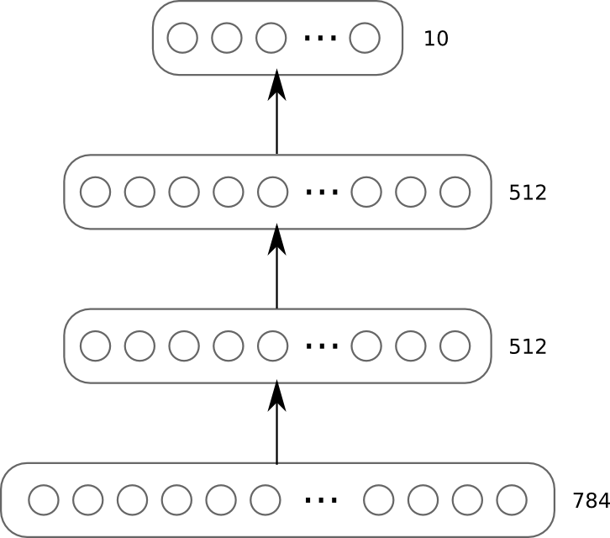

Multilayer Perceptrons - MLPs
How many parameters contains the following MLP ?
Model
3 layer neural network (2 hidden layers)
Tanh units (activation function)
512-512-10
Softmax on top layer
28
28

Slide 7
Multilayer Perceptrons - MLPs
How many parameters contains the following MLP ?
Layer | #Weights | #Biases | Total
1 | 784 x 512 | 512 | 401,920
2 | 512 x 512 | 512 | 262,656
3 | 512 x 10 | 10 | 5,130
 |  |  | 669,706
28
28

